Slide 1
Cross Platform Views
MvvmCross
Stuart Lodge

Slide 2
Current MvvmCross Workflow

Slide 3
Current MvvmCross Workflow
Create Services – ‘Back end’ – PCL .cs
Create ViewModels – PCL .cs
Create Views
.AXML - Mono for Android – (tablet and) phone
.XIB and .cs - MonoTouch for iOS – iPad and iPhone
.XAML - WP7 and WinRT

Slide 4
Current MvvmCross Workflow
Create Services – ‘Back end’ – PCL .cs
Create ViewModels – PCL .cs
Create Views
.AXML - Mono for Android – (tablet and) phone
.XIB and .cs - MonoTouch for iOS – iPad and iPhone
.XAML - WP7 and WinRT

Slide 5
Current MvvmCross Workflow
Create Services – ‘Back end’ – PCL .cs
Create ViewModels – PCL .cs
Create Views
.AXML - Mono for Android – (tablet and) phone
.XIB and .cs - MonoTouch for iOS – iPad and iPhone
.XAML - WP7 and WinRT

Slide 6
Problems?
The current workflow is good
100% code is shared at the data behaviour level.
And we want custom Native UIs on each platform… so it’s acceptable to invest time there
But, it would be nice…
… if we could share some code at the View level too
… if we could have a “quick start” for each platform

Slide 7
Cross Platform UIs

Slide 8
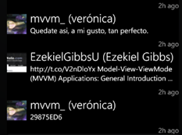


Cross Platform UIs?
There are of 3 UIs I’d like to make ‘generic’:
Lists
Forms
Tabs/Pivots

Slide 9
Cross Platform UIs?
There are of 3 UIs I’d like to make ‘generic’:
Lists
Forms
Tabs/Pivots
Need some kind of description of ListItem/Cell layout
probably using a ‘Grid’.
with Text, Images, Buttons

Slide 10
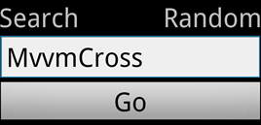
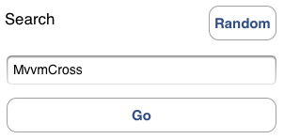

Cross Platform UIs?
There are of 3 UIs I’d like to make ‘generic’:
Lists
Forms
Tabs/Pivots

Slide 11
Cross Platform UIs?
There are of 3 UIs I’d like to make ‘generic’:
Lists
Forms
Tabs/Pivots
Defined using JSON – bound to XXX.Dialog
Prototyped with MonoDroid.Dialog:
https://github.com/slodge/Android.Dialog/issues/4

Slide 12
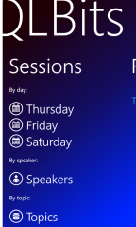
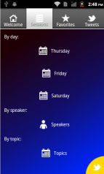
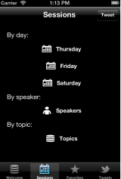
Cross Platform UIs?
There are of 3 UIs I’d like to make ‘generic’:
Lists
Forms
Tabs/Pivots

Slide 13
Cross Platform UIs?
There are of 3 UIs I’d like to make ‘generic’:
Lists
Forms
Tabs/Pivots
Don’t know what this is yet…
… but will probably be simple JSON

Slide 14
A First Experiment

Slide 15
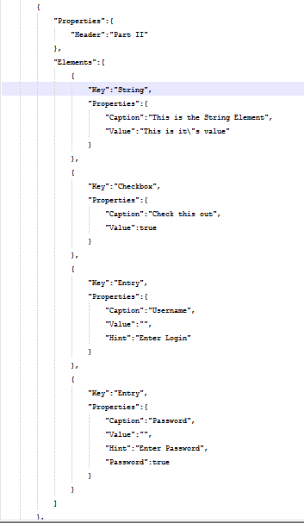
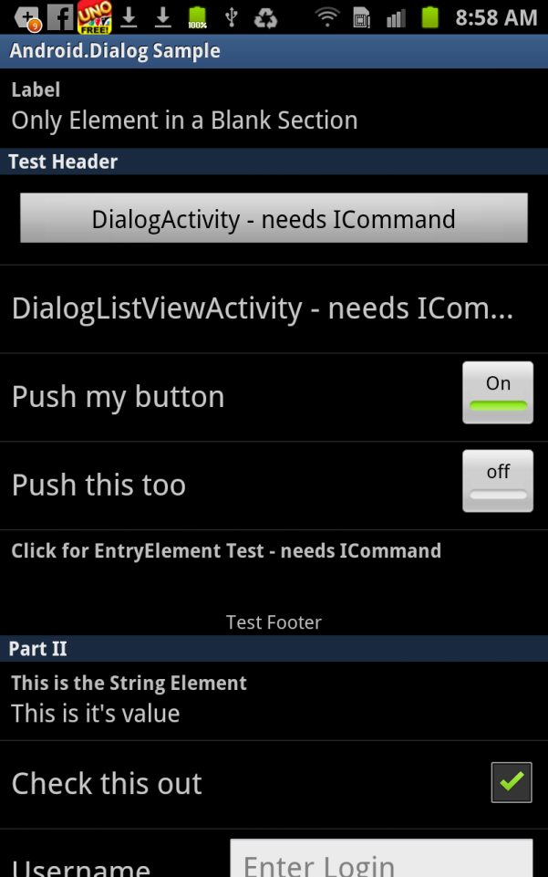
MonoDroid Dialog Experiment

Slide 16
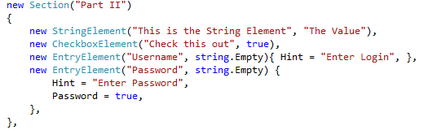
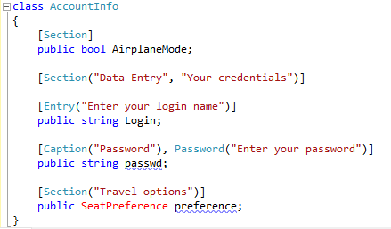
MonoDroid Dialog Experiment
I *love* the results…
But the JSON is not as compact as the C#:
And there is still that other C# reflection API too…

Slide 17
New MvvmCross Workflow

Slide 18
New MvvmCross Workflow
Create Services – ‘Back end’ – PCL .cs
Create ViewModels – PCL .cs
Create Shared Views - .json
Optionally override shared Views for special cases (home pages, maps, special features, etc)
.AXML - Mono for Android – (tablet and) phone
.XIB and .cs - MonoTouch for iOS – iPad and iPhone
.XAML - WP7 and WinRT

Slide 19
New MvvmCross Workflow
Create Services – ‘Back end’ – PCL .cs
Create ViewModels – PCL .cs
Create Shared Views - .json
Optionally override shared Views for special cases (home pages, maps, special features, etc)
.AXML - Mono for Android – (tablet and) phone
.XIB and .cs - MonoTouch for iOS – iPad and iPhone
.XAML - WP7 and WinRT

Slide 20
New MvvmCross Workflow
Create Services – ‘Back end’ – PCL .cs
Create ViewModels – PCL .cs
Create Shared Views - .json
Optionally override shared Views for special cases (home pages, maps, special features, etc)
.AXML - Mono for Android – (tablet and) phone
.XIB and .cs - MonoTouch for iOS – iPad and iPhone
.XAML - WP7 and WinRT

Slide 21
New MvvmCross Workflow
Create Services – ‘Back end’ – PCL .cs
Create ViewModels – PCL .cs
Create Shared Views - .json
Optionally override shared Views for special cases (home pages, maps, special features, etc)
.AXML - Mono for Android – (tablet and) phone
.XIB and .cs - MonoTouch for iOS – iPad and iPhone
.XAML - WP7 and WinRT

Slide 22
**Optional**
New MvvmCross Workflow
Idea is to allow users to create JSON files which provide Default Layouts for their ViewModels
These Default Layouts provide good native UIs – they will be ‘good enough’ for many apps.
But individual apps can always opt out of default layouts – they can always override some or all default layouts with platform specific layouts.

Slide 23
Finally…
This is an idea at present
I’m going to implement something…
And it will be MS-Pl open source…
If you’re interested – if you love something or hate something – then let me know
@slodge

